Slide 1



Introduction to
for data analytics
- Rohan Chikorde

Slide 2


Topics
About me
Introduction to Analytics & Data Science
Introduction to SQL in Data Analytics
SQL Job Roles
SQL basic commands and syntax
Advanced queries
Handson – Analytics Case Study using SQL
Salary of a Data Scientist
Q&A

Slide 3


About me:
Vice President – AIML @ BNY Mellon
Been in the industry for ~9 years
Previous companies – General Mills, Accenture, etc
Engineering in CS & PG in Machine Learning
20+ Certifications in DS, ML, DL
Other work:
Technical reviewer/editorial board of Packt Publishing Company
Mentoring and Consulting for AI and ML
https://www.linkedin.com/in/rohan-chikorde/

Slide 4
Introduction

Slide 5
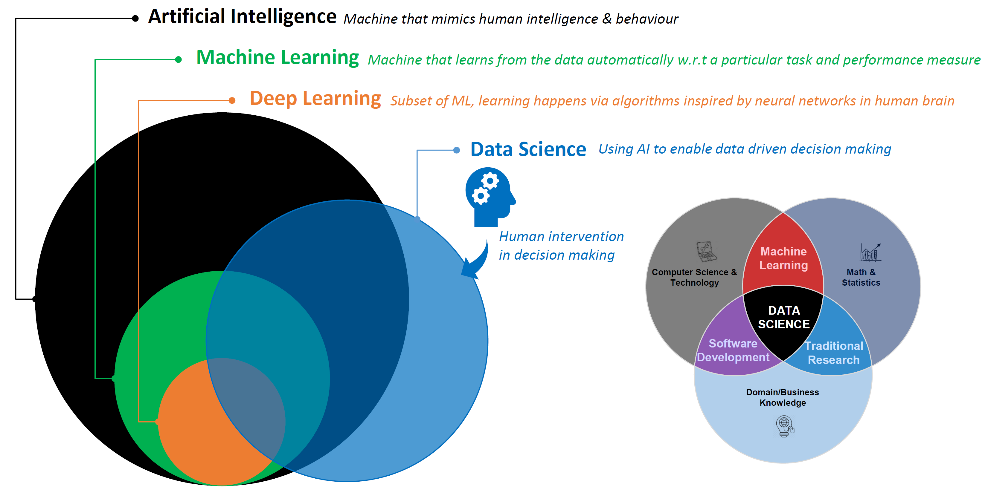

Introduction to Analytics & Data Science
Skills Required

Slide 6

Introduction to

Slide 7

Introduction to SQL
SQL (Structured Query Language) is a programming language that is commonly used for managing and manipulating relational databases.
In the world of data analytics, SQL is a powerful tool for accessing, querying, and analyzing large datasets.
One of the primary benefits of using SQL for data analytics is that it allows you to quickly and easily extract specific data from a database, regardless of its size.
SQL is also highly versatile and can be used for a wide range of data analysis tasks.
Another key advantage of SQL is that it is widely supported and easy to learn. Many databases, such as MySQL, Microsoft SQL Server, and Oracle, support SQL natively

Slide 8

Introduction to MySQL
MySQL is an open-source relational database management system (RDBMS) that is widely used for managing and manipulating data.
One of the key advantages of MySQL is its scalability. It can be used for small projects or large-scale enterprise applications, and can handle multiple users and large volumes of data.
MySQL is also known for its ease of use and flexibility. It is compatible with a wide range of programming languages, platforms, and operating systems, and can be easily integrated with other tools and technologies.
Additionally, because it is open-source software, it is freely available for download and use, making it an accessible and cost-effective solution for many organizations.

Slide 9
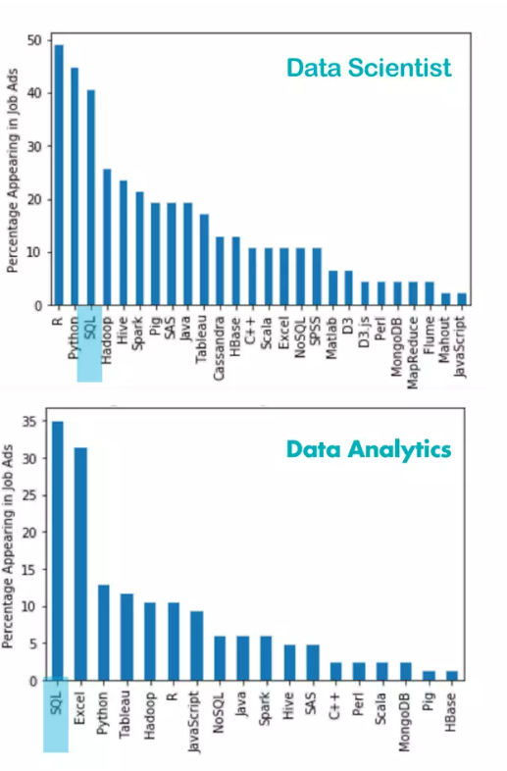
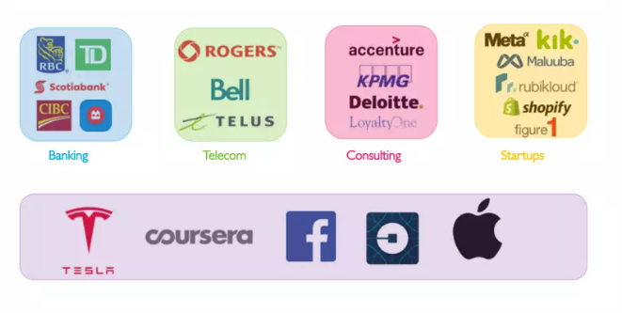
SQL Job Roles
There are multiple opportunities using SQL skills:
Data Scientist
Data Analyst
Business Analyst
Web Designer
Software Engineer
SQL Developer
Database Administrator
Database Developer
ETL Developer
…
Ref: https://www.slideshare.net/weclouddata/sql-for-data-science-201969262

Slide 10
How upGrad helps in building a career in Data Science domain
Certification from Best Institutes round the globe
Cutting-edge curriculum
Best-in class faculty
Daily Doubt Resolution Support
Mentorship and Placement Services
Earn certifications from best universities like IIIT-Bangalore, IIMK, University of Arizona, University of Maryland etc
The curriculum of the programs are built by industry leaders and academians keeping industry at the center
The courses are taught by best faculty from industry and institutes to give an all-round exposure to the students
Learn at the time of your own convenience and get your doubts resolved on the same day in the daily doubt resolution sessions
Don’t just learn the skills, but get placement support and all-round development for applying and cracking the job roles
1
2
3
4
5

Slide 11
SQL Basic commands and Syntax
Retrieving all columns from a table:
SELECT * FROM sales;
Retrieving specific columns from a table:
SELECT customer_id, first_name, last_name
FROM sales;
Filtering data using a WHERE clause:
SELECT * FROM orders
WHERE customer_id = ‘123’
AND total_amount > 100;
Sorting data using the ORDER BY clause:
SELECT * FROM sales
ORDER BY date ASC, amount DESC;

Slide 12
SQL Basic commands and Syntax
Aggregating data using the GROUP BY clause:
SELECT product_id, COUNT(*) AS sales_count
FROM sales
GROUP BY product_id
6.Using the LIMIT clause to limit the number of rows returned:
SELECT * FROM customers LIMIT 10;
7.Calculating aggregates on subsets of data using the HAVING clause:
8.Using wildcards to search for data using the LIKE operator:
SELECT product_id, COUNT(*) AS sales_count FROM sales
GROUP BY product_id
HAVING COUNT(*) > 10;
SELECT * FROM products
WHERE product_name LIKE '%phone%';

Slide 13

Value: Most Comprehensive & Personalized Learning Experience in entire higher ed. ecosystem
Advantages
Get practical usable skills + a degree/certificate
Online videos allow watching/rewatching at own pace & deepen conceptual understanding
Live learning helps address doubts and learn in classroom setting
Personalized elements such as PI sessions & industry mentors help deepen personalized understanding & address individual learning gaps
Doubt clearing sessions Q&A forums ensure one gets every small doubt resolved
Learner Need
To have in depth learning of all concepts/no learning gap
To have a learning experience similar to the offline they have experienced earlier
But with more hands on skill based learning
Features
A powerful mix of recorded content and live sessions
1-15 PI sessions
1-1 Industry Mentor Sessions
Doubt Solving Sessions
Integrations of hands on /practical elements such as simulations/case studies/capstone projects

Slide 14
SQL Advanced queries and Syntax
9.Using the CASE statement to create custom conditions and calculated fields:
SELECT employee_id, first_name, last_name, salary,
CASE
WHEN salary > 50000 THEN 'High’
ELSE 'Low’
END AS salary_category
FROM employees;
10. Using subqueries:
SELECT * FROM orders
WHERE customer_id IN
(SELECT customer_id
FROM customers
WHERE last_name = 'Smith');

Slide 15
SQL Advanced queries and Syntax
11. Using joins:
SELECT employees.first_name, employees.last_name, departments.department_name
FROM employees
INNER JOIN departments
ON employees.department_id = departments.department_id;

Slide 16
Value: Constant Hand Holding & Support
Advantages
We ensure that learner keeps pace with learning and not gets stuck
Quick resolutions of issues whenever learner gets suck studying at home
Stress and hassle free experience of learning anywhere and anytime
Learner Need
Fear of lagging/getting lost /mission out on important deliverables.
For a human companion to guide in the journey
Features
upGrad Buddy for your cohort
Constant Tech Support
Dedicated Grievance Handling team
Q&A forum
Doubt Resolution Sessions

Slide 17
Hands-on Demo
Analytics Case Study using SQL

Slide 18
Value: 100% Career Outcome Oriented Learning
Advantages
Learn only the key skills that will lead to tangible career benefits and not useless content
Learn Hands on applications on skills and not just theoretical knowledge
Learner Need
To feel secured that the study investment
(money, time, effort) will yield career returns
Features
Curriculum based on Industry Needs (SME+ Recruiters)
High Level of Industry Projects/Case Studies/Simulations
Career Oriented PI sessions, 1-1 Mentorship sessions, 1-1 Coaching Sessions

Slide 19

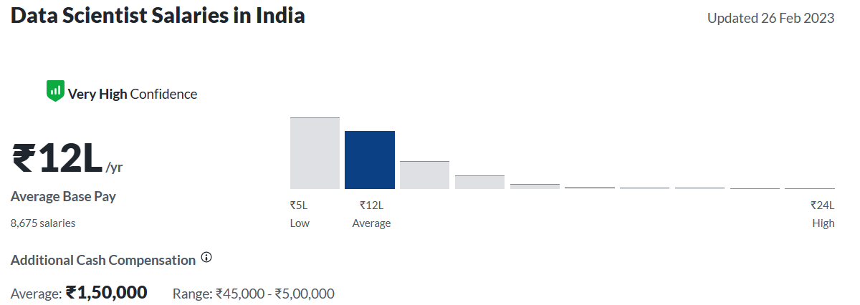
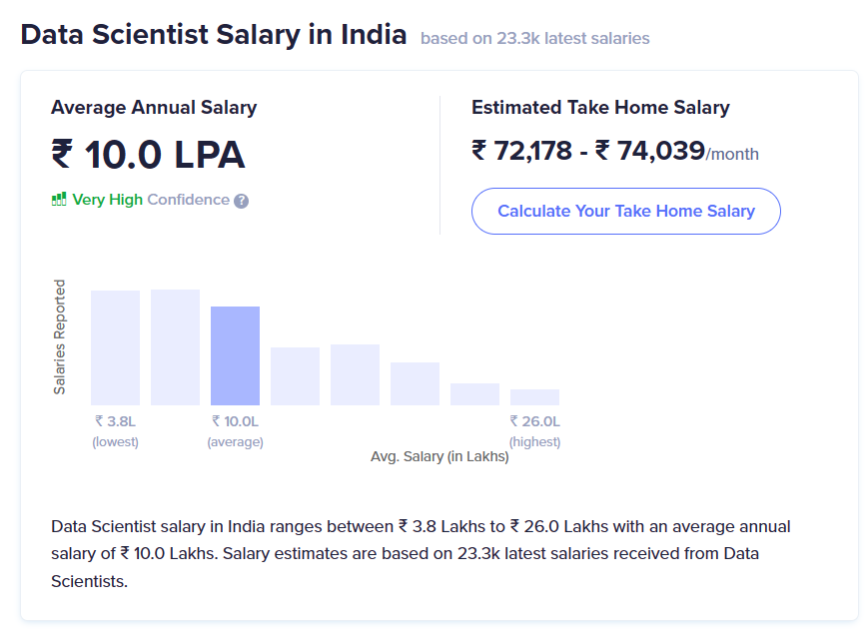

Data Scientist Salaries in India

Slide 20
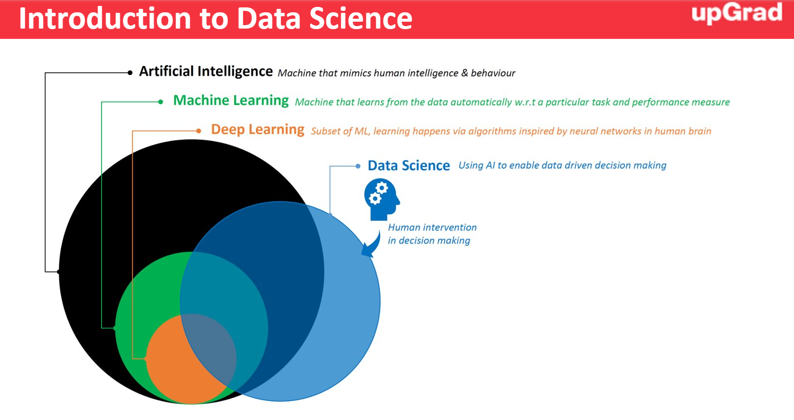
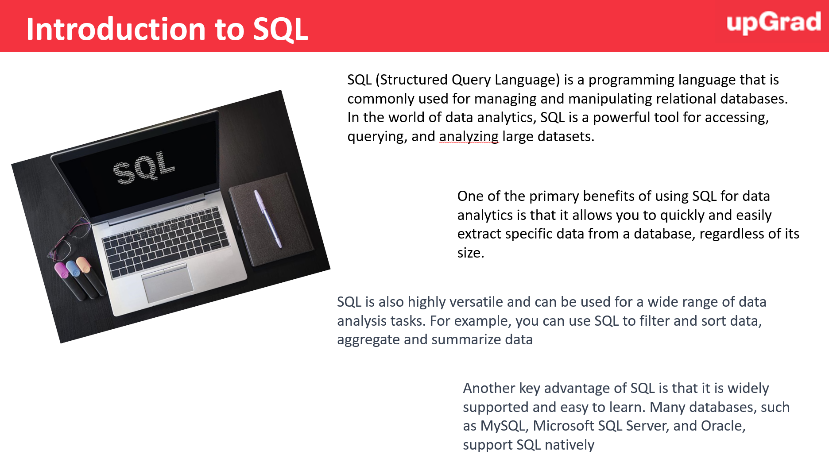
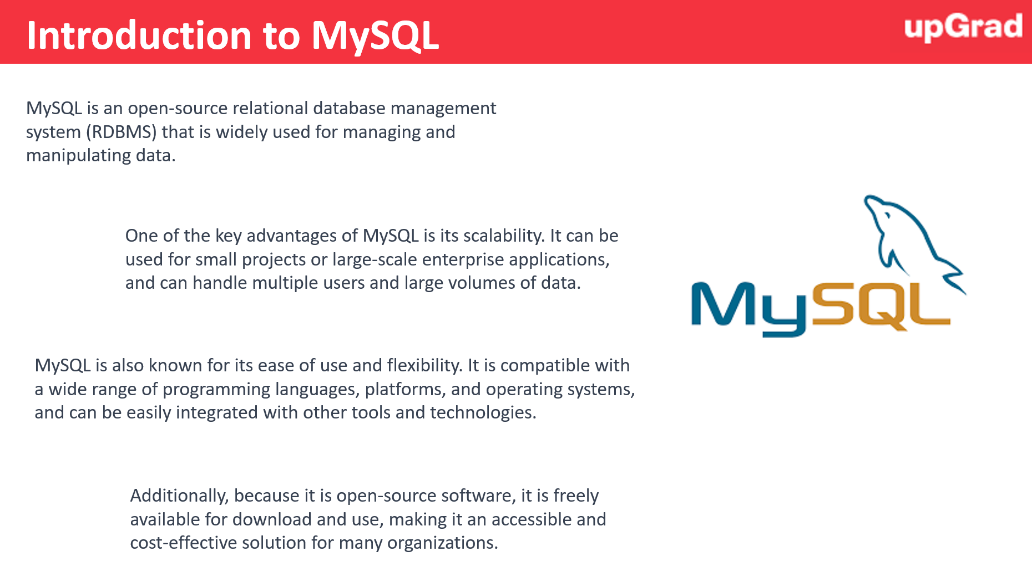
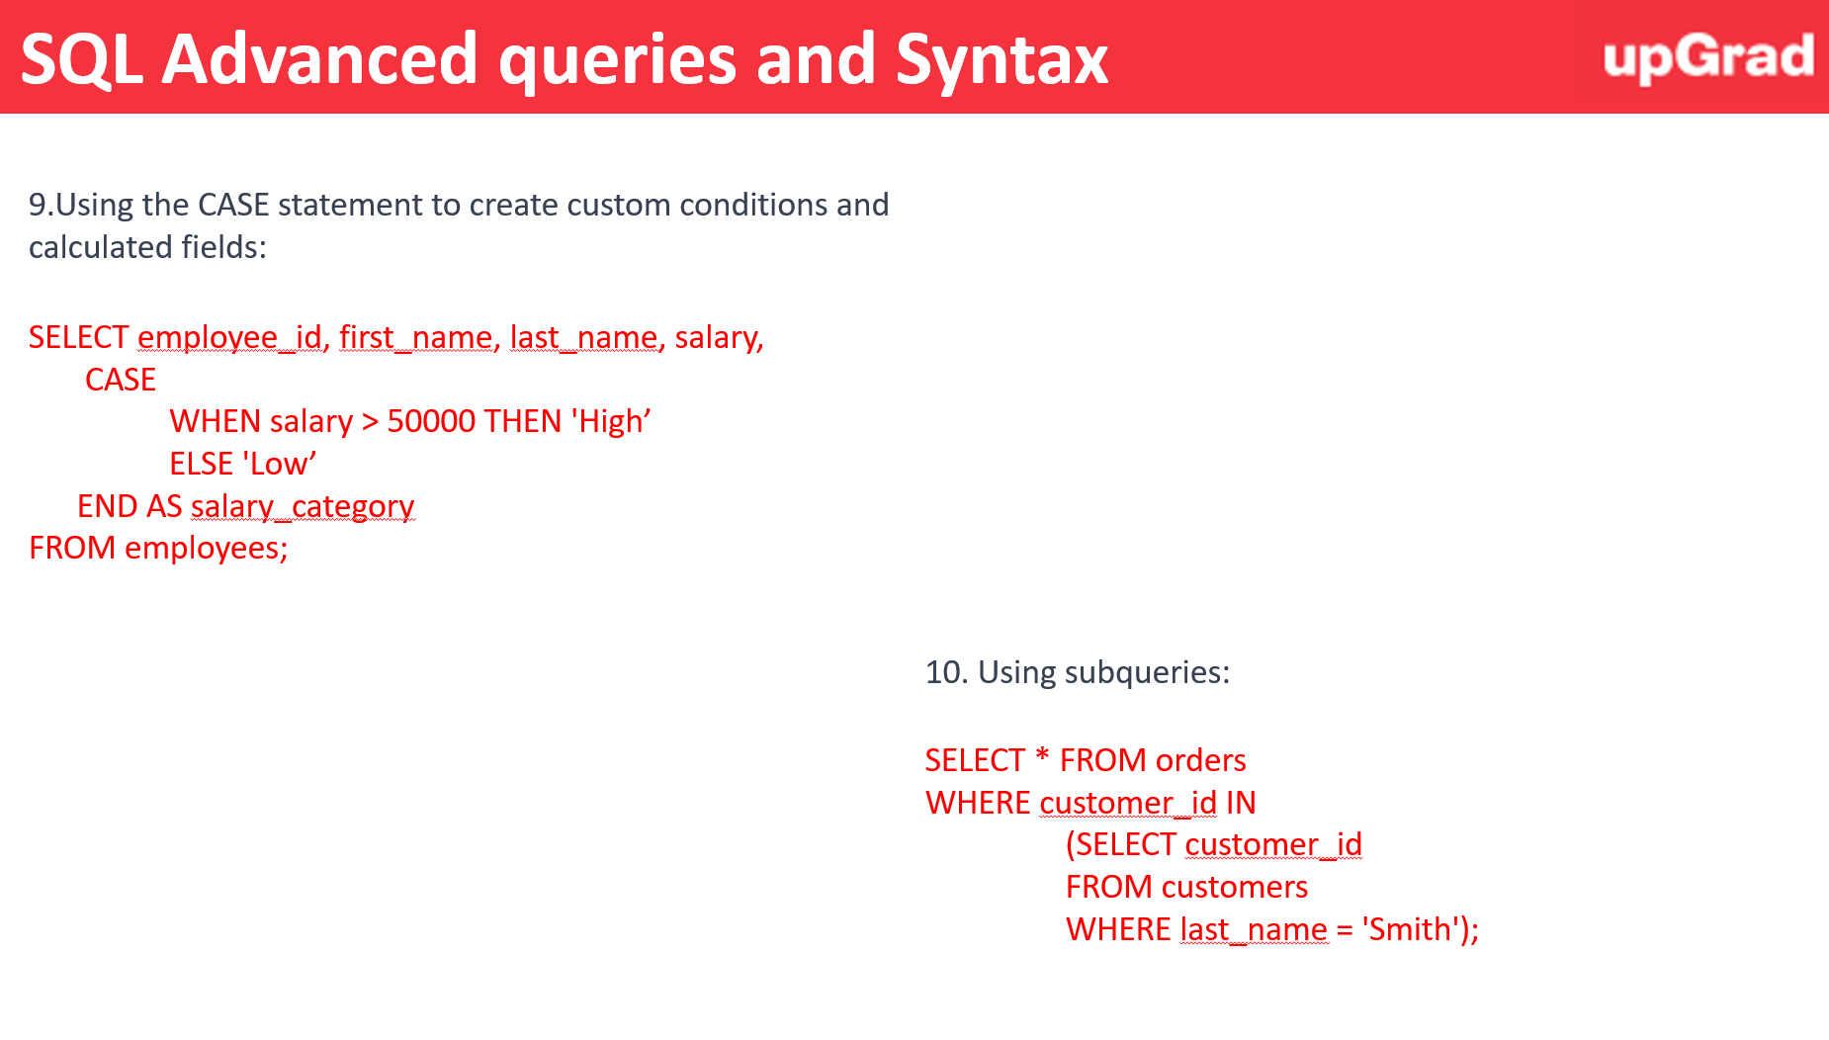
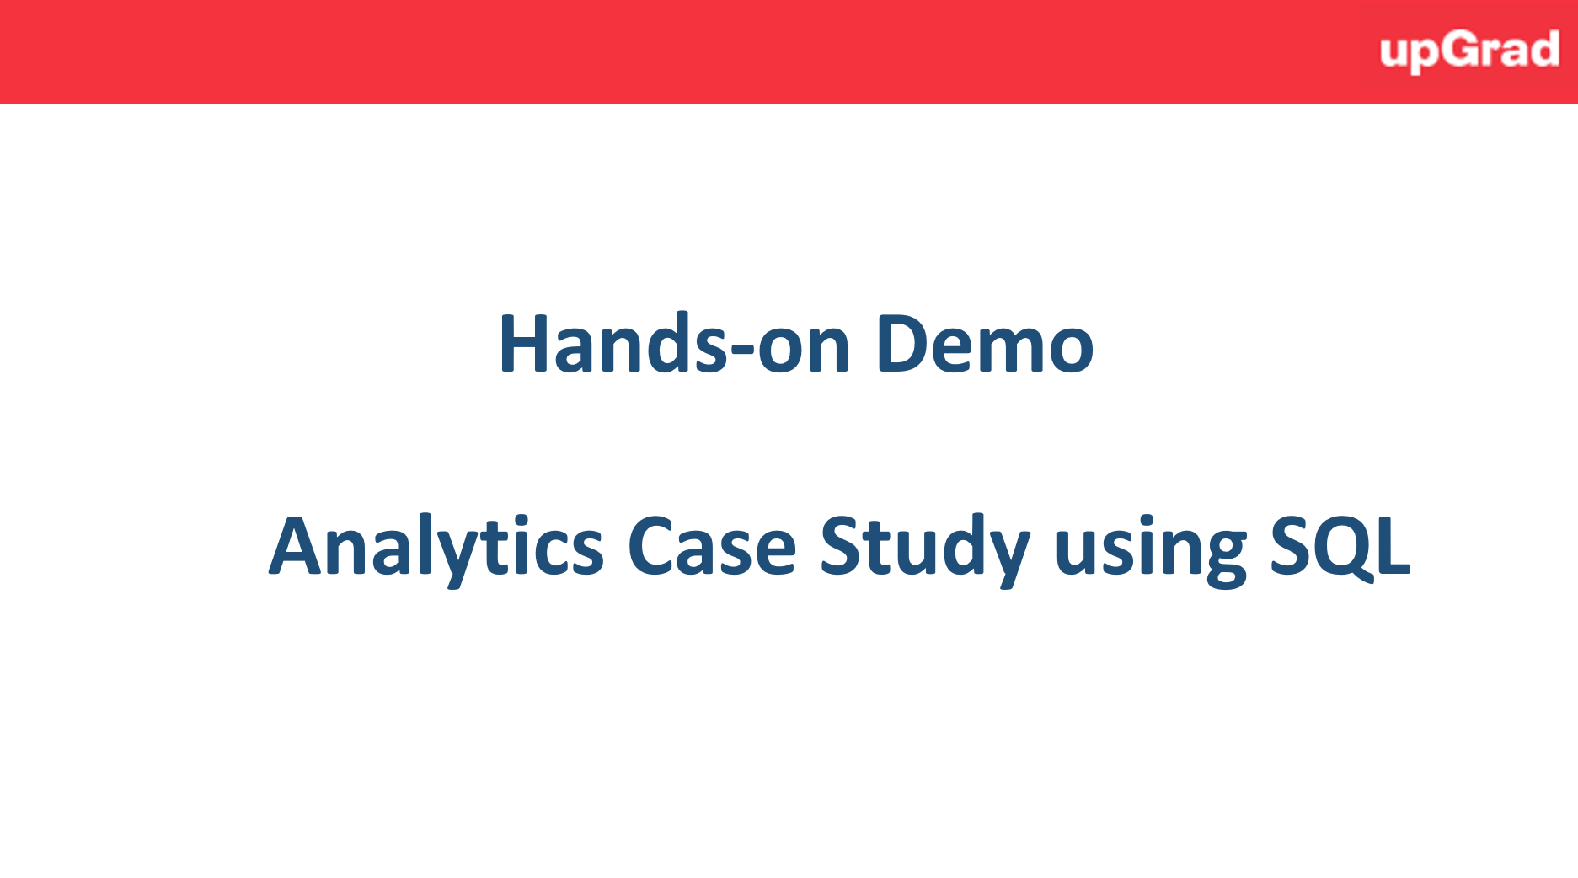
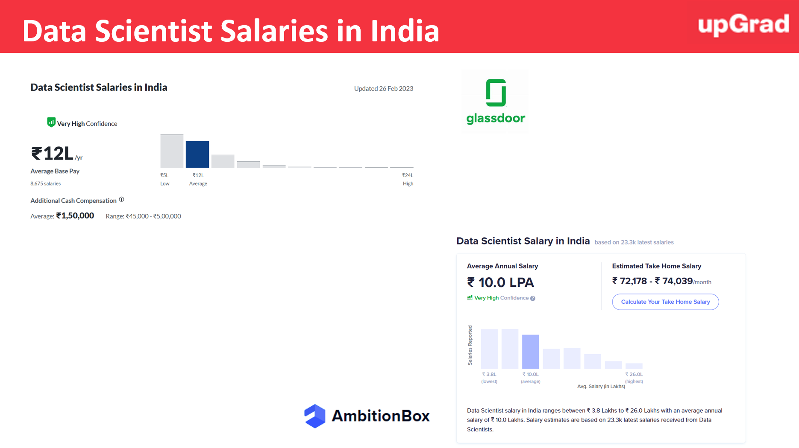
Summary & Key Takeaway

Slide 21
A glance into your journey once you enroll with a Data Science & Machine Learning course
Features Offered
Duration
Program Phase
Access to job portal
High Performance Coaching
6 months - ∞
Alumni Phase
In this phase, the learners has access to course content for 3 years. Frequent online meetups and sessions on trending topics in the field of Data Science are conducted for all alumnus of upGrad
3-6 months
Career Phase (3-6 months after program completion)
Personalized career mentor
LinkedIn Profile and Resume Builder
1:1 Mock Interviews (on request)
In this phase, every learner is assigned a career coach to provide to personalized guidance and action plan to achieve the desired outcomes. Mock-interviews can be scheduled on request basis in a very short time.
Access to job portal
High Performance Coaching
9-12 months
In-program Phase
Daily Doubt Resolution
Every week the learner learns a new concept, practices the concept, and clears graded questions at the time of his/her convenience (through recorded videos and upGrad platform). Exams are conducted twice in the entire program to test the learnings and help learners revise the concepts learnt The learner gets access to job portal and can start applying to the roles of interest. The curriculum is designed in a manner to help gain both hard skills and soft skills to crack the interviews.
Access to learning platform
Live Sessions with top experts
Personalized Industry Mentorship
Access to Job portal
Soft Skills module
Interview Prep
1:1 Mock Interviews (on request)
Pre-Launch Preparatory Phase
0-90 days
Once the learner clears entrance test and enrolls into the program, the learner has access to preparatory content to help revise the important concepts and come into the zone of studying and learning
Access to learning platform

Slide 22


